Slide 1
RAE-SWIG QAPP
Technical Assistance
2024
Presented by
Tom Ardito, Margherita Pryor,
Nora Conlon, Chelsea Glinka
November 19, 2024

Slide 2
Meeting with you today
Tom Ardito
Chelsea Glinka
SNEP Watershed Implementation Grant Program Director
Senior Environmental Scientist/Project Manager
Kaitlynne Morris
Senior Transportation Planner
Margherita Pryor
Nora Conlon
SNEP Project Officer
Quality Assurance Officer

Slide 3
Overview of the Southeast New England Program for Watershed Implementation Grants (SWIG)
Margherita Pryor, EPA
Falmouth Rod and Gun Club
Childs River Dam Removal & River Restoration (2018/2019)

Slide 4
Quality Assurance Project Plan (QAPP)
Chelsea Glinka
Why is a QAPP needed?
What types of projects require a QAPP?
Primary data collection (i.e. water quality sampling)
Secondary data collection
How should a QAPP be structured?
Basic/Primary Data Collection Template
Secondary Data Collection Template
Modeling Template
Nantucket Conservation Foundation
Windswept Bog Wetland Restoration (2023)

Slide 5
EPA QAPP Standards and Guidance Documents
Nora Conlon, EPA
QAPP Standards
EPA Requirements
Guidance for QAPPs
Woonasquatucket River Watershed Council
Woonasquatucket River Greenway (2019)

Slide 6
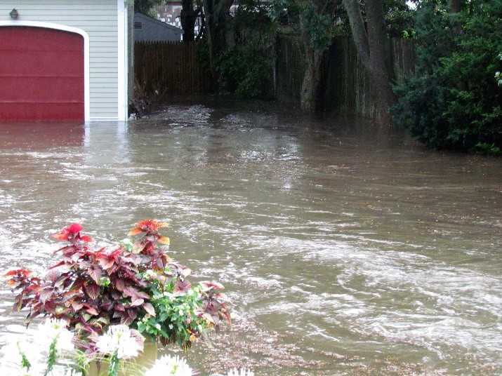
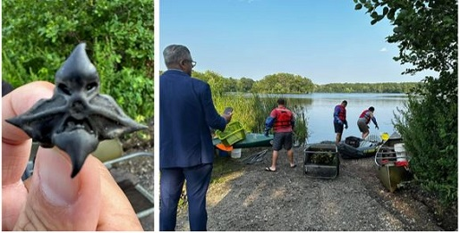
Southeast New England Program for Watershed Implementation Grants (SWIG)
Frequently Asked Questions
City of Newport
Non-Structural Stormwater Approaches (2019)
New England Water Pollution Control Commission (NEIWPCC)
Community-Based Habitat Restoration: Water Chestnut Management in the Blackstone & Ten Mile Watersheds (2022)

Slide 7
QAPP Review Process and Timeline
Submit draft to VHB
Update as per comments
Send to EPA for review/approval at least 60 days prior to start of data collection
Allow for up to 3 months for review
Make Edits as per EPA review
Circulate approved QAPP to Project Team
New England Water Pollution Control Commission (NEIWPCC)
Community-Based Habitat Restoration: Water Chestnut Management in the Blackstone & Ten Mile Watersheds (2022)

Slide 8
Questions?

